Slide 1
Forget the Ones
Courtney Burch
Gateway Community and Technical College
Covington, KY

Slide 2
Solving a System of Equations
2x + 4y = -1
3x +3y = 1
If we want to eliminate x:
3(2x + 4y = -1)
-2(3x + 3y = 1)
6x + 12y = -3
-6x - 6y = -2
6y = -5 y = -5/6
If we want to eliminate y:
3(2x + 4y = -1)
-4(3x + 3y = 1)
6x + 12y = -3
-12x -12y = -4
-6x = -7
x = 7/6

Slide 3
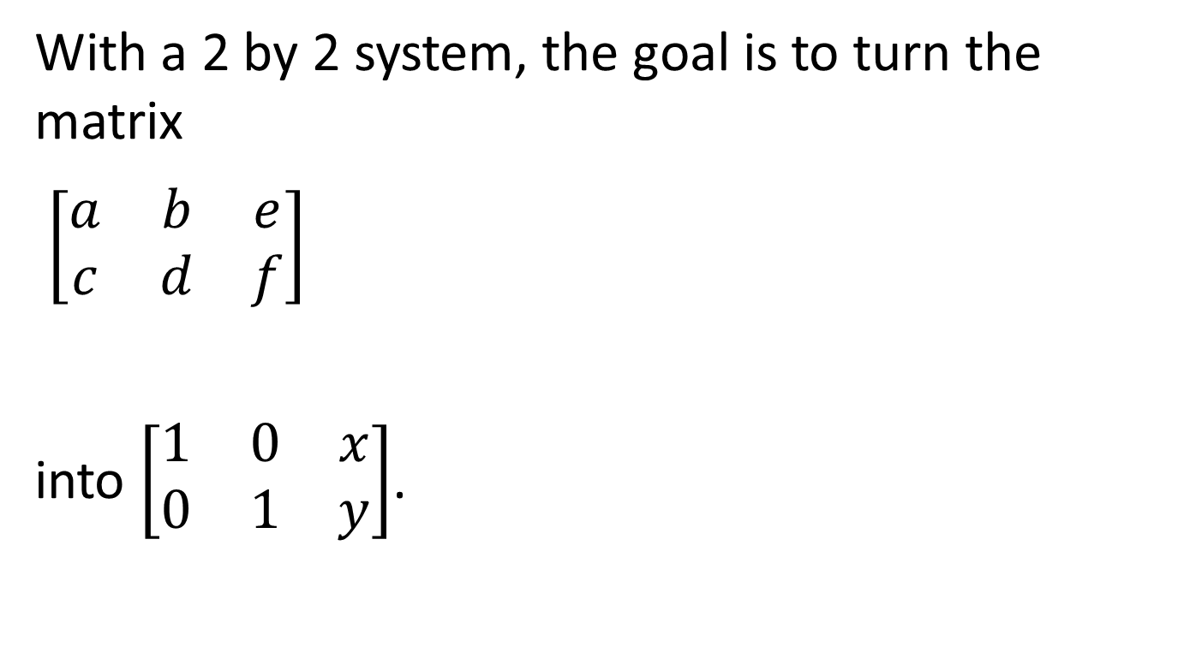
Gauss-Jordan Elimination
With a 2 by 2 system, the goal is to turn the matrix
$\left[\begin{matrix}a & b & e \\ c & d & f\end{matrix}\right]$
into $\left[\begin{matrix}1 & 0 & x \\ 0 & 1 & y\end{matrix}\right]$.

Slide 4
How do we teach this?
Method 1: Write a problem with numbers you like.
Then when you are doing your example, everything works out nicely!

Slide 5

Nice Example:
Solve x + 5y = 7
-2x + 7y = -5
Augmented Matrix:
$$\left[\begin{matrix}1 & 5 & 7 \\ −2 & −7 & −5\end{matrix}\right]$$

Slide 6
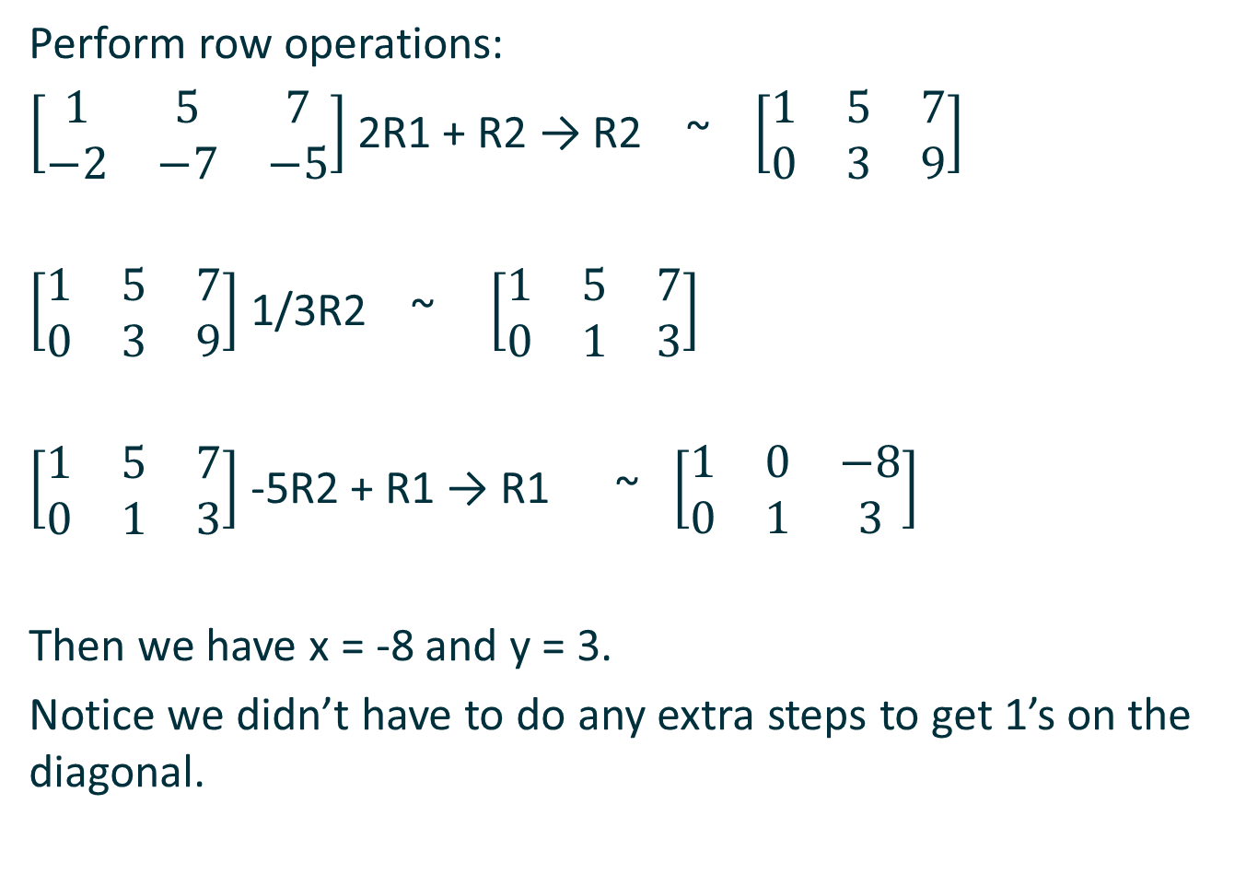
Perform row operations:
$\left[\begin{matrix}1 & 5 & 7 \\ −2 & −7 & −5\end{matrix}\right]$ 2R1 + R2 → R2 ~ $\left[\begin{matrix}1 & 5 & 7 \\ 0 & 3 & 9\end{matrix}\right]$
$\left[\begin{matrix}1 & 5 & 7 \\ 0 & 3 & 9\end{matrix}\right]$ 1/3R2 ~ $\left[\begin{matrix}1 & 5 & 7 \\ 0 & 1 & 3\end{matrix}\right]$
$\left[\begin{matrix}1 & 5 & 7 \\ 0 & 1 & 3\end{matrix}\right]$ -5R2 + R1 → R1 ~ $\left[\begin{matrix}1 & 0 & −8 \\ 0 & 1 & 3\end{matrix}\right]$
Then we have x = -8 and y = 3.
Notice we didn’t have to do any extra steps to get 1’s on the diagonal.

Slide 7
Fraction Method
Method 2: Use fractions to turn numbers on the diagonal into 1.
To turn any number on the diagonal into 1, divide the row by that number.
Then use the 1 to turn the rest of the column into 0.

Slide 8
Advantages and disadvantages
Advantages:
This method works on every problem.
Students can follow the same sequence of steps on every problem.
A 2x2 system can always be solved in 4 steps.
Disadvantages:
Fractions
Students are relying on a calculator to do the work for them(in most cases).

Slide 9
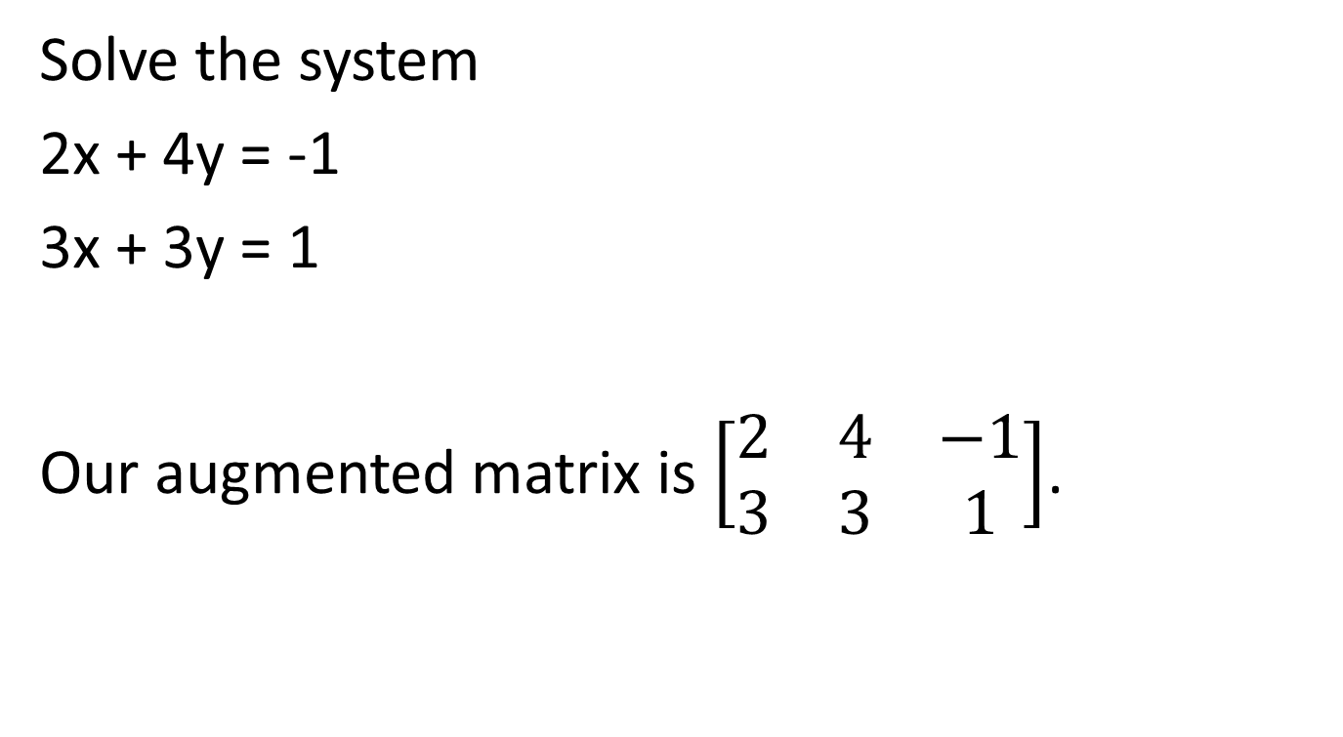
Fraction Method Example
Solve the system
2x + 4y = -1
3x + 3y = 1
Our augmented matrix is $\left[\begin{matrix}2 & 4 & −1 \\ 3 & 3 & 1\end{matrix}\right]$.

Slide 10

Step 1: Turn the 2 in Row 1 Column 1 into 1, by dividing Row 1 by 2.
$\left[\begin{matrix}2 & 4 & −1 \\ 3 & 3 & 1\end{matrix}\right]$ ½ R1 ~ $\left[\begin{matrix}1 & 2 & −1/2 \\ 3 & 3 & 1\end{matrix}\right]$.

Slide 11
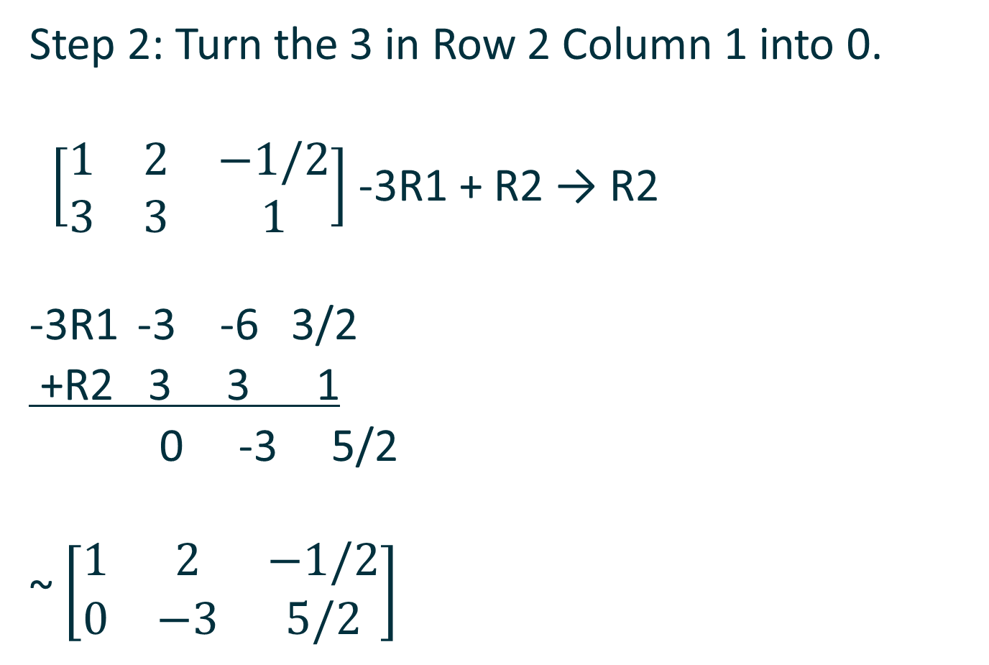
Step 2: Turn the 3 in Row 2 Column 1 into 0.
$\left[\begin{matrix}1 & 2 & −1/2 \\ 3 & 3 & 1\end{matrix}\right]$ -3R1 + R2 → R2
-3R1 -3 -6 3/2
+R2 3 3 1
0 -3 5/2
~ $\left[\begin{matrix}1 & 2 & −1/2 \\ 0 & −3 & 5/2\end{matrix}\right]$

Slide 12

Step 3: Turn the -3 in Row 2 Column 2 into 1 by dividing Row 2 by -3.
$\left[\begin{matrix}1 & 2 & −1/2 \\ 0 & −3 & 5/2\end{matrix}\right]$ -1/3 R2 ~ $\left[\begin{matrix}1 & 2 & −1/2 \\ 0 & 1 & −5/6\end{matrix}\right]$

Slide 13

Step 4: Turn the 2 in Row 1 Column 2 into 0.
$\left[\begin{matrix}1 & 2 & −1/2 \\ 0 & 1 & −5/6\end{matrix}\right]$ -2R2 + R1 → R1
R1 1 2 -1/2
-2R2 0 -2 10/6
1 0 7/6
~ $\left[\begin{matrix}1 & 0 & 7/6 \\ 0 & 1 & −5/6\end{matrix}\right]$
So we have x = 7/6 and y = -5/6.

Slide 14
Linear Combinations
Method 3: Use linear combinations to turn numbers on the diagonal into 1.

Slide 15
Advantages and disadvantages
Advantages:
Fewer fractions to deal with (sometimes)
Disadvantages:
Most difficult for students to figure out what steps to take.
May not be possible depending on the numbers in the problem.
When a workable linear combination is difficult or impossible to locate– what do we do then? (Hint: We’re not sure.)

Slide 16
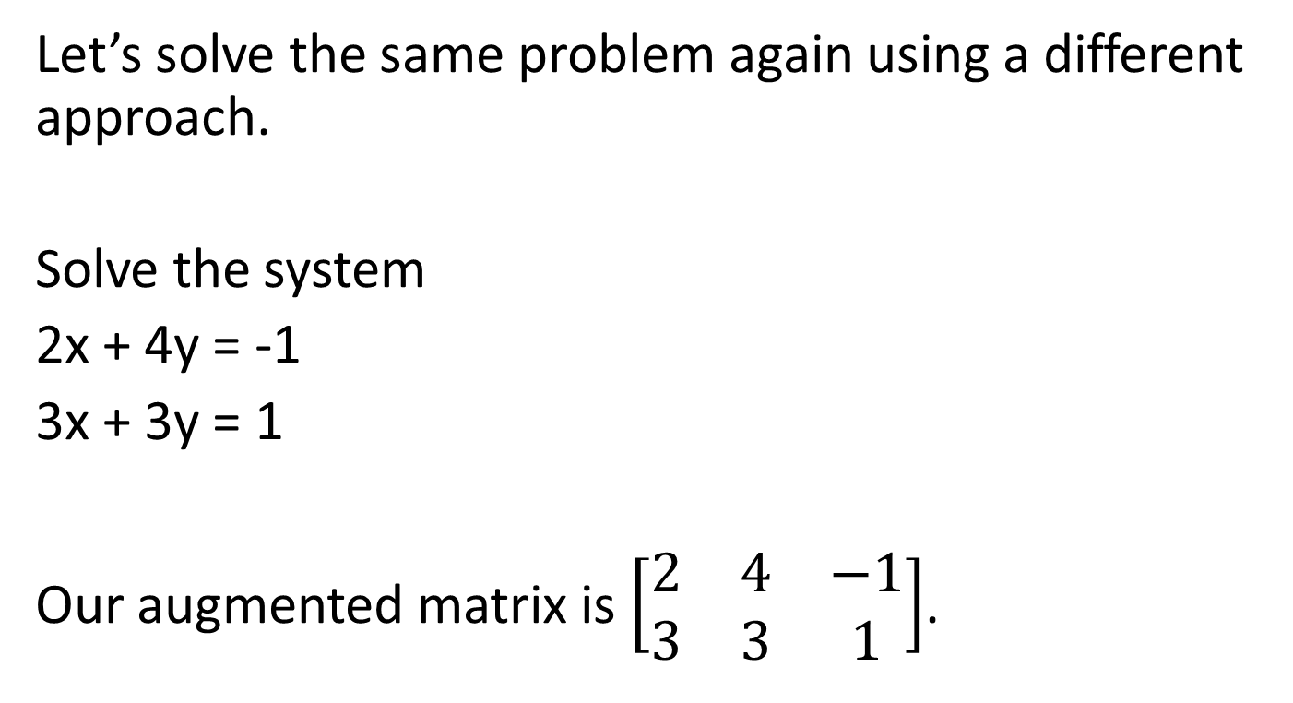
Linear Combination Method
Let’s solve the same problem again using a different approach.
Solve the system
2x + 4y = -1
3x + 3y = 1
Our augmented matrix is $\left[\begin{matrix}2 & 4 & −1 \\ 3 & 3 & 1\end{matrix}\right]$.

Slide 17
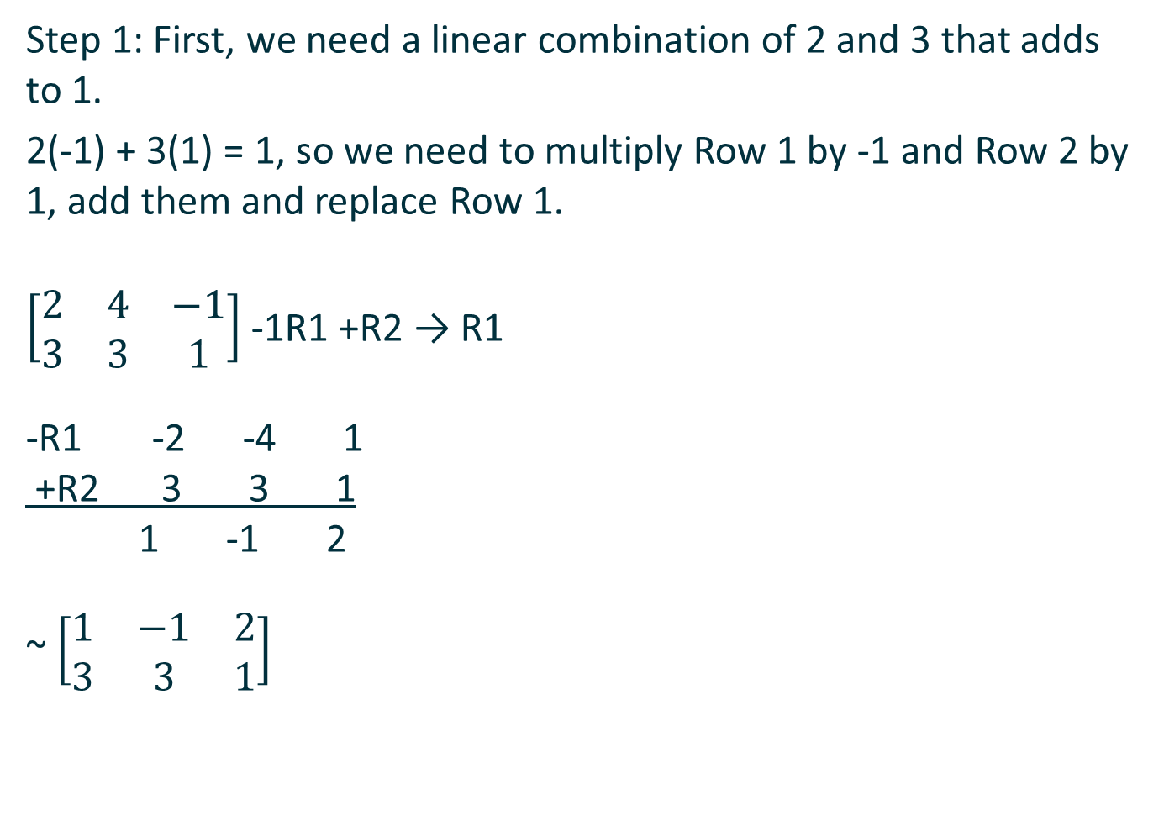
Step 1: First, we need a linear combination of 2 and 3 that adds to 1.
2(-1) + 3(1) = 1, so we need to multiply Row 1 by -1 and Row 2 by 1, add them and replace Row 1.
$\left[\begin{matrix}2 & 4 & −1 \\ 3 & 3 & 1\end{matrix}\right]$ -1R1 +R2 → R1
-R1 -2 -4 1
+R2 3 3 1
1 -1 2
~ $\left[\begin{matrix}1 & −1 & 2 \\ 3 & 3 & 1\end{matrix}\right]$

Slide 18

Step 2: Turn the 3 in Row 2 Column 1 into 0.
$\left[\begin{matrix}1 & −1 & 2 \\ 3 & 3 & 1\end{matrix}\right]$-3R1 + R2 → R2
-3R1 -3 3 -6
+R2 3 3 1
0 6 -5
~$\left[\begin{matrix}1 & −1 & 2 \\ 0 & 6 & −5\end{matrix}\right]$.

Slide 19
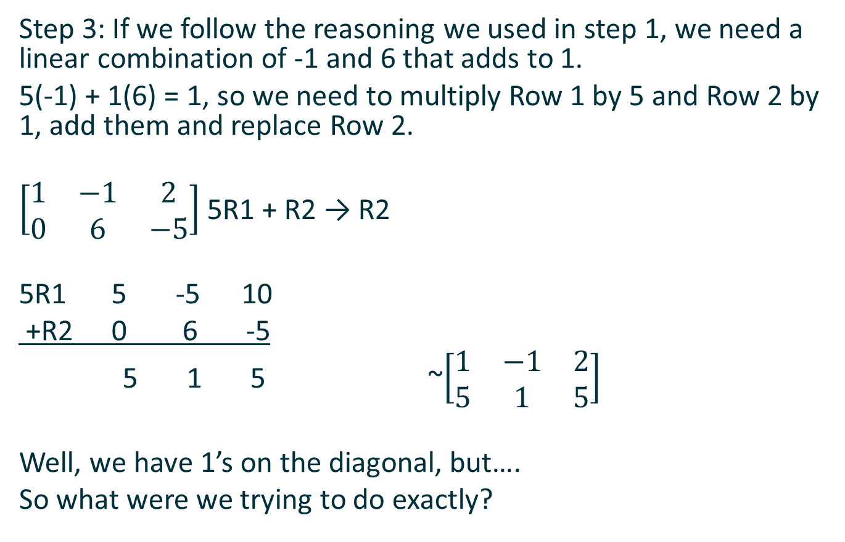
Step 3: If we follow the reasoning we used in step 1, we need a linear combination of -1 and 6 that adds to 1.
5(-1) + 1(6) = 1, so we need to multiply Row 1 by 5 and Row 2 by 1, add them and replace Row 2.
$\left[\begin{matrix}1 & −1 & 2 \\ 0 & 6 & −5\end{matrix}\right]$ 5R1 + R2 → R2
5R1 5 -5 10
+R2 0 6 -5
5 1 5 ~$\left[\begin{matrix}1 & −1 & 2 \\ 5 & 1 & 5\end{matrix}\right]$
Well, we have 1’s on the diagonal, but….
So what were we trying to do exactly?

Slide 20
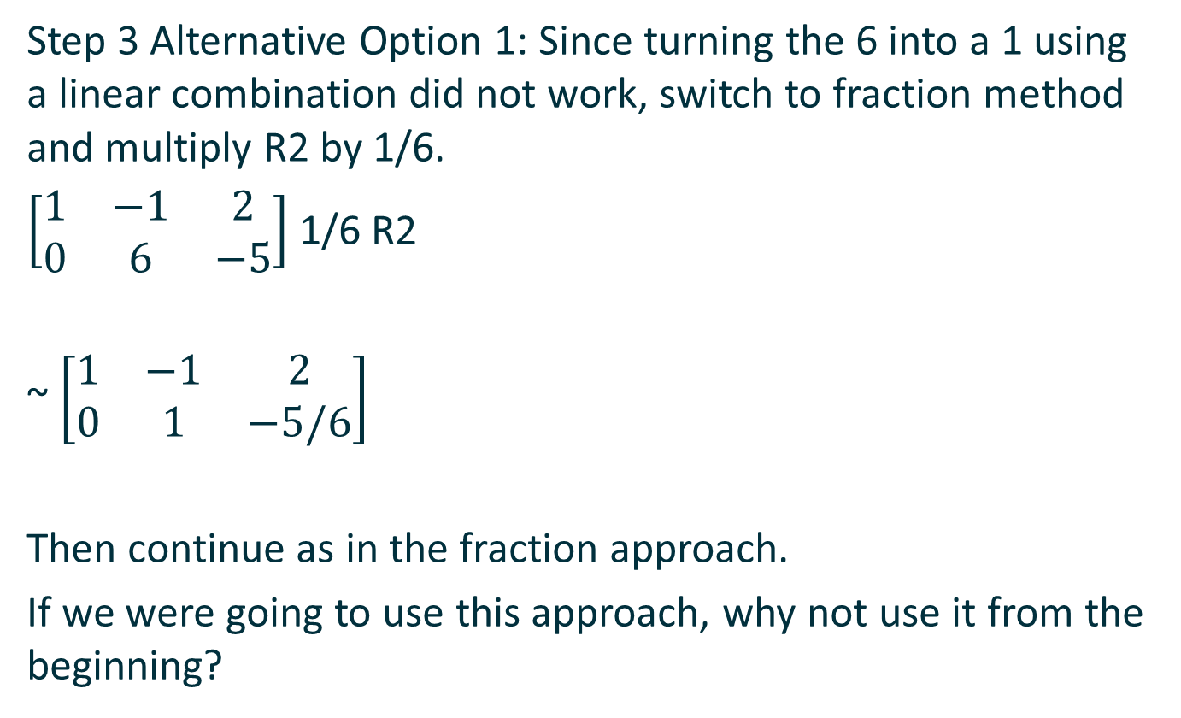
Step 3 Alternative Option 1: Since turning the 6 into a 1 using a linear combination did not work, switch to fraction method and multiply R2 by 1/6.
$\left[\begin{matrix}1 & −1 & 2 \\ 0 & 6 & −5\end{matrix}\right]$ 1/6 R2
~ $\left[\begin{matrix}1 & −1 & 2 \\ 0 & 1 & −5/6\end{matrix}\right]$
Then continue as in the fraction approach.
If we were going to use this approach, why not use it from the beginning?

Slide 21
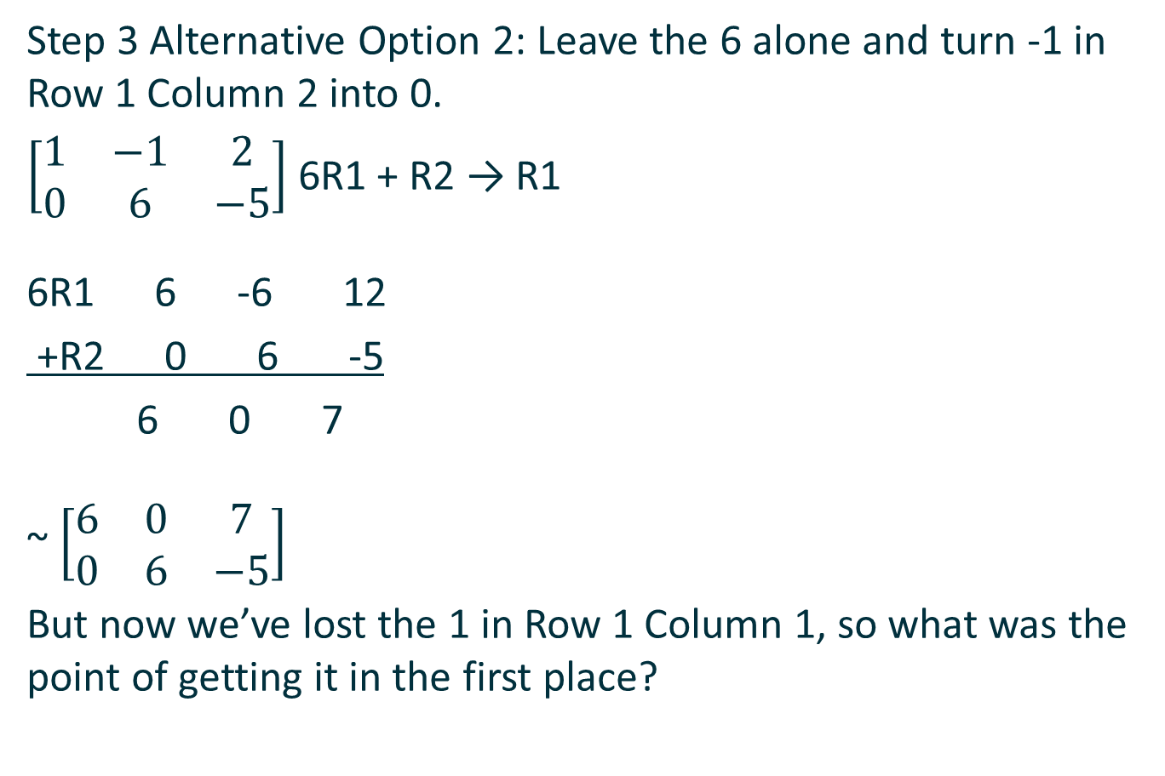
Step 3 Alternative Option 2: Leave the 6 alone and turn -1 in Row 1 Column 2 into 0.
$\left[\begin{matrix}1 & −1 & 2 \\ 0 & 6 & −5\end{matrix}\right]$ 6R1 + R2 → R1
6R1 6 -6 12
+R2 0 6 -5
6 0 7
~ $\left[\begin{matrix}6 & 0 & 7 \\ 0 & 6 & −5\end{matrix}\right]$
But now we’ve lost the 1 in Row 1 Column 1, so what was the point of getting it in the first place?

Slide 22
My Method: Forget the Ones
Focus solely on obtaining 0s using the numbers on the diagonal, no matter what they are.
Get ones in the last step by dividing.

Slide 23
Advantages and Disadvantages
Advantages:
No operations with fractions
No need to come up with linear combinations
Can always be solved with the same four steps
Mirrors students’ experience using elimination to solve a system of equations.
Disadvantages:
Not shown in the textbook or examples, so it’s hard to get buy-in from students

Slide 24
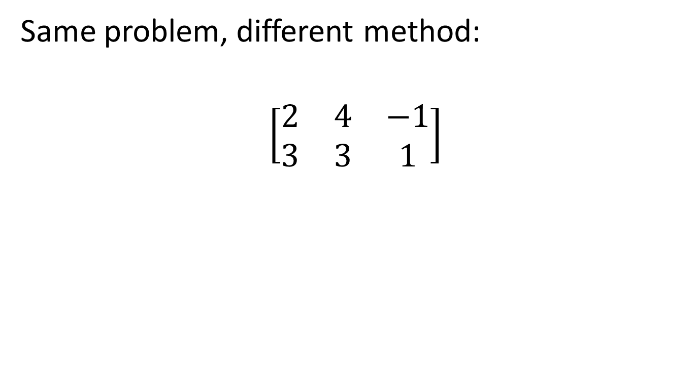
My Method
My Method
Same problem, different method:
$$\left[\begin{matrix}2 & 4 & −1 \\ 3 & 3 & 1\end{matrix}\right]$$

Slide 25
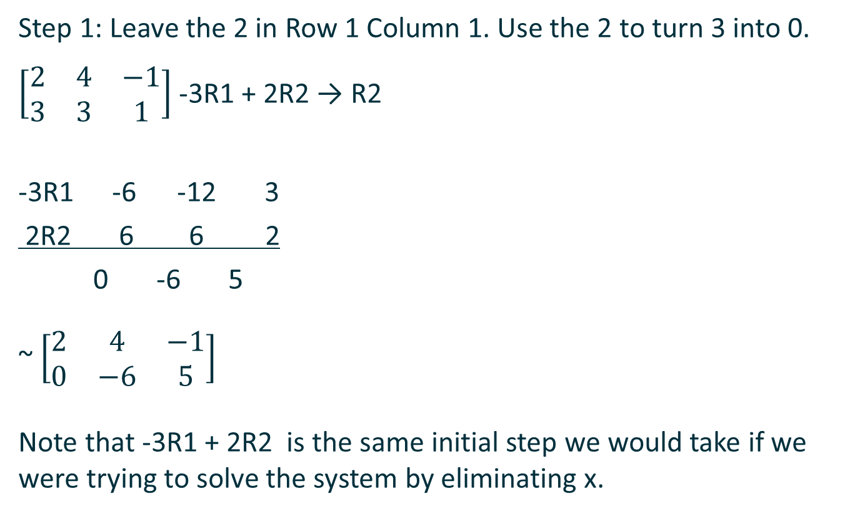
Step 1: Leave the 2 in Row 1 Column 1. Use the 2 to turn 3 into 0.
$\left[\begin{matrix}2 & 4 & −1 \\ 3 & 3 & 1\end{matrix}\right]$ -3R1 + 2R2 → R2
-3R1 -6 -12 3
2R2 6 6 2
0 -6 5
~ $\left[\begin{matrix}2 & 4 & −1 \\ 0 & −6 & 5\end{matrix}\right]$
Note that -3R1 + 2R2 is the same initial step we would take if we were trying to solve the system by eliminating x.

Slide 26
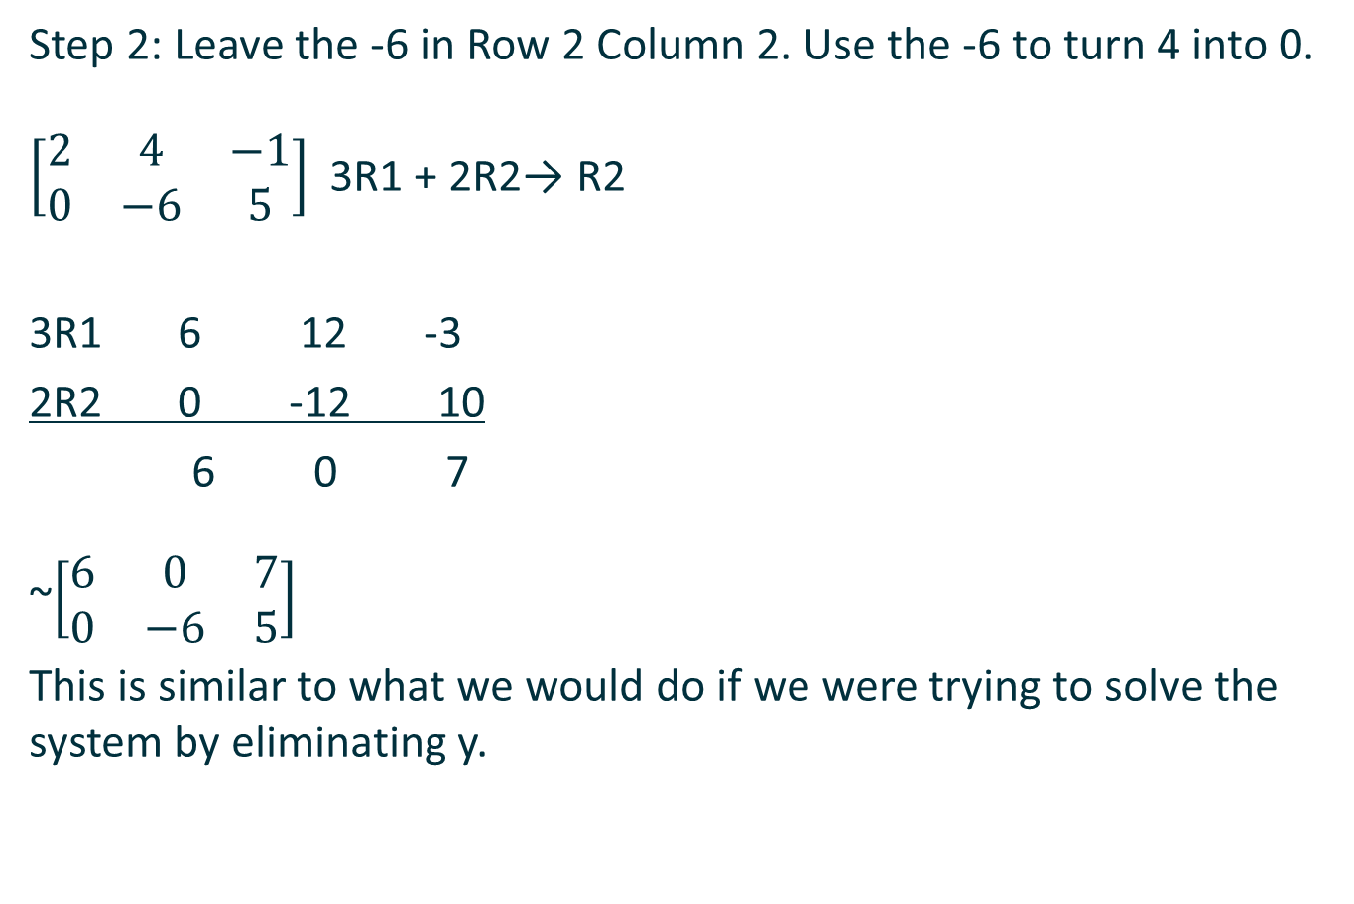
Step 2: Leave the -6 in Row 2 Column 2. Use the -6 to turn 4 into 0.
$\left[\begin{matrix}2 & 4 & −1 \\ 0 & −6 & 5\end{matrix}\right]$3R1 + 2R2→ R2
3R1 6 12 -3
2R2 0 -12 10
6 0 7
~$\left[\begin{matrix}6 & 0 & 7 \\ 0 & −6 & 5\end{matrix}\right]$
This is similar to what we would do if we were trying to solve the system by eliminating y.

Slide 27

Step 3 and 4: Divide Row 1 by 6 and Row 2 by -6
$\left[\begin{matrix}6 & 0 & 7 \\ 0 & −6 & 5\end{matrix}\right]$1/6 R1, -1/6 R2
~ $\left[\begin{matrix}1 & 0 & 7/6 \\ 0 & 1 & 5/6\end{matrix}\right]$

Slide 28
Have I had any success with this method?
I have tried every semester, when I teach MAT 165, to get students to adopt this method.
Some will use it, others use the fraction method because that is what our textbook shows in every example.
Students seem to understand the steps of the fraction method, but they are using calculators to compute the numbers.

Slide 29
Your thoughts?

