Slide 1
The Invention of the
Complex Numbers

Slide 2
Statement
Complex numbers were invented to solve equations like:

Slide 3
WRONG!

Slide 4
Equations such as x² + 4 = 0 were considered unsolvable, useless, and worthless.
They were in the same category as the equations:
e^{x} = –1 and cos x = 2.

Slide 5
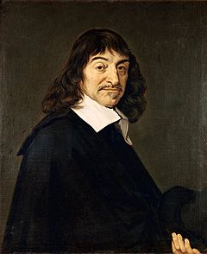
René Descartes (1596–1650)
“Neither the true (positive) nor
the false (negative) roots are
always real ... sometimes they
are imaginary.ˆ”
en.wikipedia.org/

Slide 6
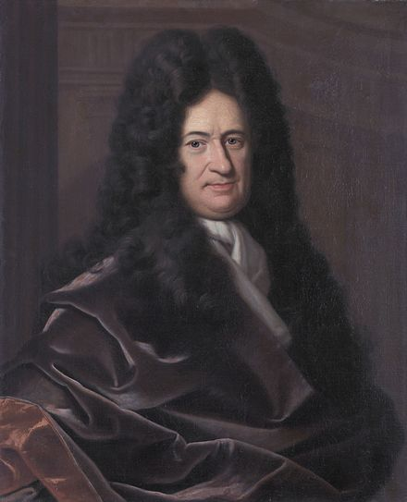
Gottfried Leibniz (1646-1716)
Characterized as:
“... that amphibian between
being and non–being.”
https://en.wikipedia.org/wiki/Gottfried_Wilhelm_Leibniz

Slide 7
  Before the development of Coordinate Geometry in the 16th century, mathematicians sought explicit solutions to polynomial equations. They were not interested in the existence of solutions.

Slide 8
  Solution by Radicals
  Use the operations of Addition, Subtraction, Multiplication, Division, and Extraction of Roots

Slide 9
  The Quadratic Formula
  Given ax² + bx + c = 0,

Slide 10
Cardano/Tartaglia/del Ferro Formula
Given the reduced equation x³ = mx + n, one solution is:

Slide 11
Solve: x³ = 6x + 9
With m = 6 and n = 9:

Slide 12
  By the Intermediate
  Value Theorem, this cubic equation must have a real solution.
  (Only one in this case.)

Slide 13
Now let us try:
x³ = 6x + 4.

Slide 14
  By the Intermediate
  Value Theorem, this cubic equation also must have a real solution. In fact, it has three!

Slide 15
Solve: x³ = 6x + 4
With m = 6 and n = 4:

Slide 16
NOW WHAT?
Two possibilities:
Cardano’s Formula doesn’t always work.
The ”imaginary” terms involving do
lead to a real solution. In other words,
“imaginary numbers” are not worthless!

Slide 17
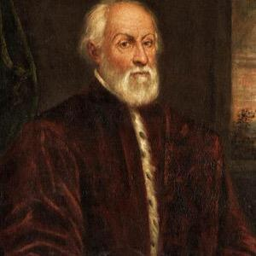
Rafael Bombelli (c. 1526 – c. 1572)
In his 1570 treatise Algebra, Bombelli approved the second option.
http://www.italyonthisday.com/2019/01/rafael-bombelli-mathematician.html

Slide 18
Bombelli’s Method
x³ = 6x + 4
So:

Slide 19

https://looneytunes.fandom.com/wiki/Clyde_Bunny?file=Clyde.png

Slide 20
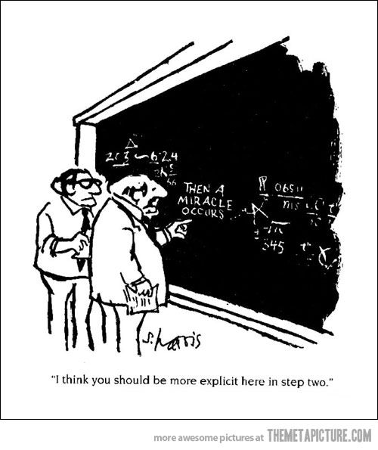
https://www.pinterest.com/pin/205899014187612340/

Slide 21
Bombelli:
“The whole matter seems to rest on sophistry rather tan on truth.”

Slide 22
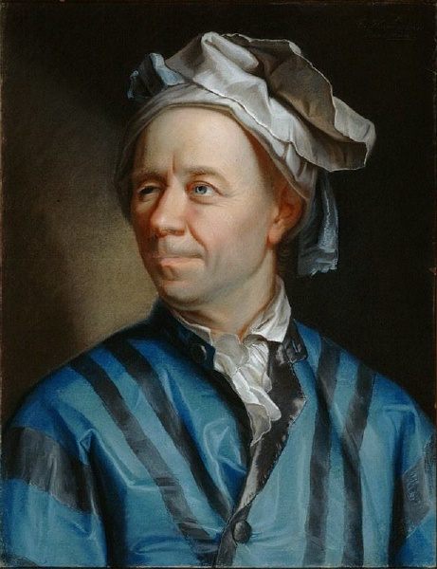
Leonhard Euler (1707–1783)
In his Elements of Algebra, Euler defined as “neither nothing, nor greater than nothing, nor less than nothing.”
He continues: “notwithstanding this .... nothing prevents us from making use of these imaginary numbers and employing them in calculation.”
https://en.wikipedia.org/wiki/Leonhard_Euler

Slide 23
Euler began his work with complex numbers while calculating the nth roots of unity.
A theorem by Abraham de Moivre (1667–1754) involving trigonometry aided Euler in his work.
In 1748, Euler stated de Moivre’s Theorem into its present form.

Slide 24
De Moivre’s Theorem
For z = a + bi,
for k = 1, 2, ..., n – 1, where
and θ = Arctan (b/a).

Slide 25
Solve: x³ = 6x + 4
With m = 6 and n = 4:

Slide 26
Cube Roots of 2 + 2i:

Slide 27
Cube Roots of 2 – 2i:

Slide 30
Other Euler Formulas
which lead to ...

Slide 32
So you have:
or:
which combine the five important constants
The Additive Identity 0
The Multiplicative Identity 1
The Constant π
The Constant e
The Imaginary Number i

Slide 33
And if cos x = 2,

Slide 34
Bibliography
Dunham, William. Euler: The Master of Us All. Washington DC: MAA, 1999.
Irving, Ron. Beyond the Quadratic Formula. MAA Inc., 2013

