Slide 1

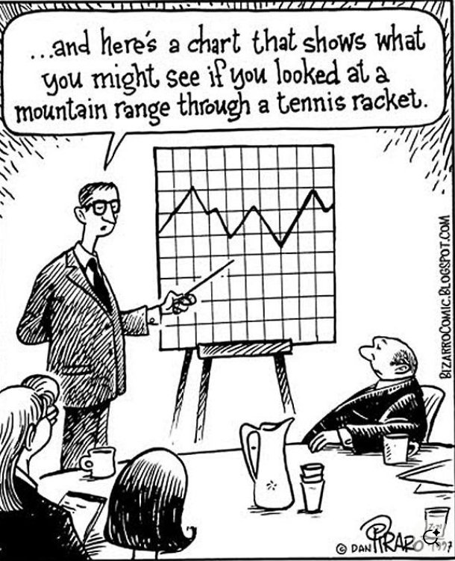
Activities for Intro Statistics
John Ward, Jefferson CTC
Statistics: Process of collecting, analyzing and describing data.
1). Helps to answer the question “How do you know?” which is why statistics is a fundamental path to knowledge in all fields.
2). The ultimate goal is to make better decisions and tame uncertainty
3). Most common confidence level: 95% so that uncertainty is 5% or less
4). Statistics is not a spectator’s sport
“Strive not to be understood but rather the impossibility of being misunderstood”
-Spurgeon
“To be great is to be misunderstood”
-Emerson
Fun ways to get students engaged in class

Slide 2
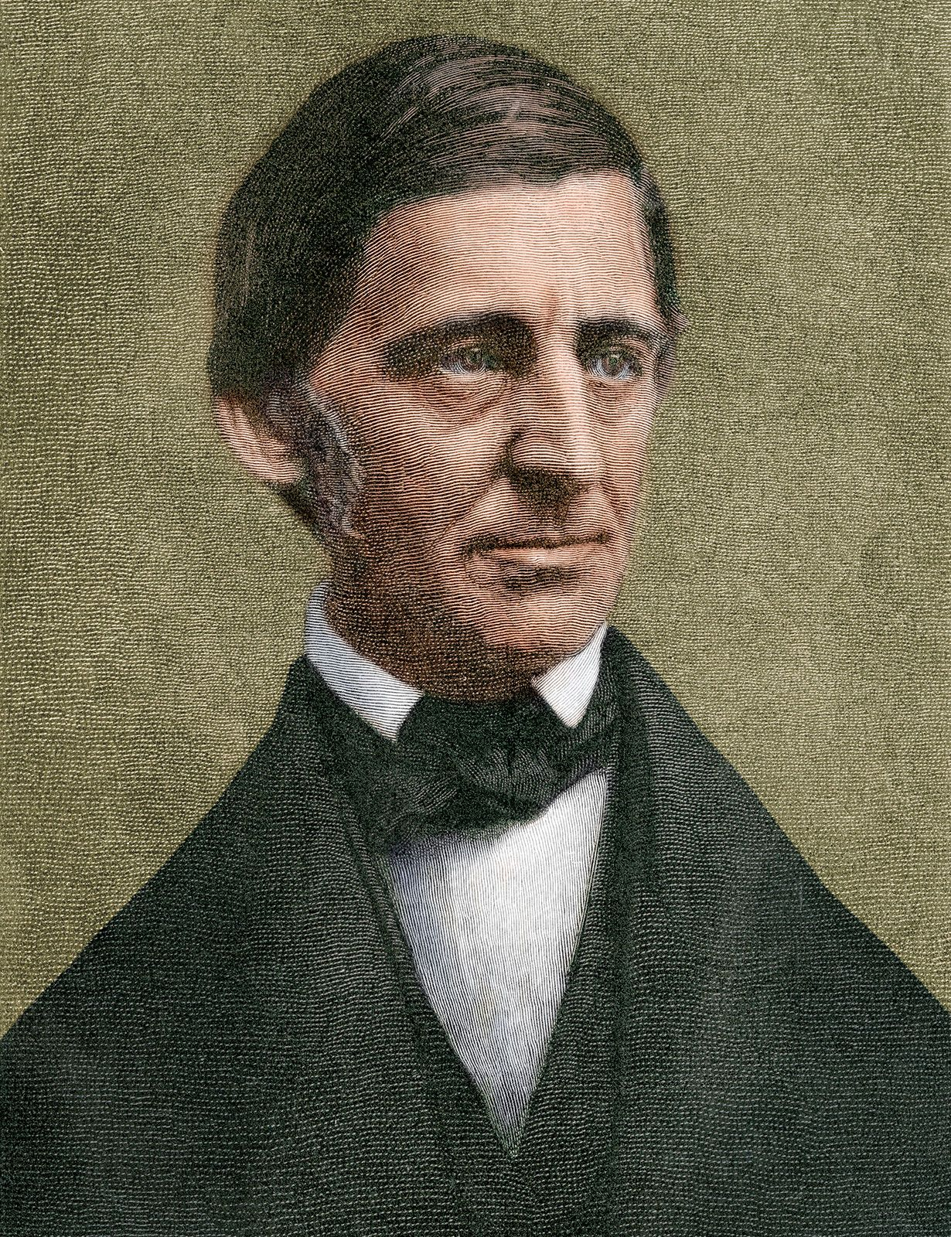
Goal of the course is a research paper on a topic(s) of student’s choice
1). Design a Google Forms Survey: 20 questions
2). Collect data: Minimum 100 responses
3). Analyze the results: Individually and 5 hypotheses for exploring potential relationships/associations. At least one of the hypotheses must be statistically significant and explored in detail.
4). Write up a paper using traditional research format: Approx. 15 pages and include Excel data file.
5). Most important criterion is having questions that students care about seeing individually and testing for relationships between the questions.
Students take my sample Google Form survey to see what they need to do to begin the process. The data is used throughout the course to illustrate concepts discussed and all tests of hypotheses.
“Nothing great was ever achieved without enthusiasm”

Slide 3
Format for the paper:
Title Page with short Abstract (summary) in single space format at bottom of the page.
Introduction (1 to 3 pages): Discuss your topic and list your hypotheses (what questions you are trying to answer- generally by analyzing potential relationships between the variables in your survey). Answer why you picked your topic, the things you want to learn and list how each question in your survey relates to the research questions that will be tested. Include a literature review where you look at background research studies or information that relates to your topic from the internet, articles, books, other classes refer to any references in the bibliography section at the end. Generally try to avoid 1st person. Ex. Instead of saying I wanted to find out, say the purpose of this research paper was to find out ...
Methods (1 to 2 pages): Explain the process of gathering your sample, that is efforts you made to make sure your sample was representative of the population that you want to generalize your findings. You
Analysis (4 to 10 pages): Your results. Follow an outline/structured format- rather that free-flowing text. - This is the body of the paper - include a small chart for each key variable in your survey and then follow each individual variable analysis by trying to show how some of the variables may be related and comment on the p-value (clearly) for any test of significance used. Make sure you explain how the contingency table shows how/if the relationship is significant.
Results (1 to 2 pages): Highlight what was found in your analysis… best way is to follow an easy-to-read table or use outline format (bullets).
Conclusion (1 page): Any comments/interpretations of results that may need further research to be substantiated, suggestions to others for further research. Ex. You may have found out that some of your questions were confusing to some people who took your survey, explain what you would do if you were to redo your survey from scratch.

Slide 4
Examples of relationships students have explored and found consistently to be statistically significant
Political affiliation (Democrat/Republican) versus:
  Should we finish border wall (yes/no)
  Stance on Abortion (pro-choice/pro-life)
  Support ban on assault weapons (yes/no)
  Do you own a gun?
  Support death penalty (yes/no)
  Support marijuana legalization (yes/no)
  Support school vouchers (reduction in private school fees)
  Know what Bull vs Bear relates to
  Are interested in current events/keep up with politics/news
  Belief that racism is still a major issue in the U.S.
  Belief that government corruption is a major issue in the U.S.
Belief in God vs Want to have kids
Had a childhood trauma vs feel like they have a good work/life balance in later life
Have high cholesterol or high blood pressure vs Are obese
Are you a procrastinator vs Are you a night owl
Gender (M/F) vs
  Believe in Fate
  Cried in last month
  Would consider adopting a child
  Read books for fun
  Gone to gym in last week
7. Introvert/Extrovert vs Risk taker/Safety first
8. Diagnosed mental issue vs
  a. Have rejection sensitivity
  b. Have cried in the last week
  c. Have trouble sleeping
  d. Have negative self-perception of one’s body
9. Can hold multiple conversations at once vs prefer to work alone or in a group
10. Do you practice yoga or meditation vs Do you garden
11. Do you consider yourself to be a very happy and optimistic person vs:
  a. Believe in miracles
  b. Exercise regularly
  c. Consider self to be religious
  d. Are married or plan to be in the future
  e. Have a good relationship with parents
12. Are you an athlete vs Do you generally eat a healthy/balanced diet?
13. Exercise regularly vs
  a. Content with physical appearance
  b. Happiness/Less likely to feel overwhelmed (“Do you often feel overwhelmed?”
  c. yes/no)

Slide 5
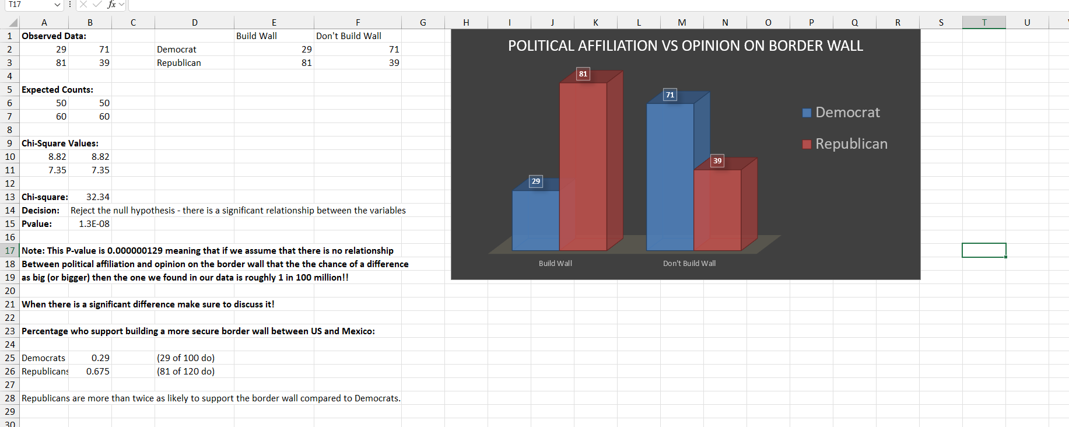
Sample papers and Excel Templates are provided as guides to help with hypotheses

Slide 6
A grading rubric makes grading the papers a little easier
7. Key components needed in the analysis section (80% of your paper)
  Summary of each of your 20 variables (usually a pie chart with a short summary) up to 20 points
  Was at least one significant relationship found? 25 pts (if you didn’t find one then pick variables that are similar and run that test and use instead of one of your other 5 comparisons. If you still can’t find one, closely examine the one with the lowest P-value – see 7f).
  Were the correct tests of hypotheses used for the data collected? 10 pts
  Were the correct tables/charts/summary statistics used? 20 pts Include side-by-side bar charts for all chi-square tests (10 points if missing).
  Were the P-values for each test listed and correct? 15 pts. Use the provided Excel templates to check your P-values if you have a 2x2, 2x3 or 2x4 matrix. If needed you can transpose a 3x2 or 4x2 matrix to use the templates and the P-values will not change. If you have larger matrices make sure to watch the videos that show you how to use the TI-83/4 calculator to find them. Make sure to only use the observed data from the pivot tables, not the row or column totals, when finding P-values for chi-square analysis used to compare categorical variables which is the most common.
  Were the correct conclusions made based on the P-values listed? 10 pts Note a common mistake is that students assert that the null hypothesis is true when P > 5%.
  If chi-square was used were proportions and a relative rate used to describe all significant relationships found. Remember that P<5% means you have found something significant. This is the heart of your research work! If you just state there is a significant relationship without exploring and describing what you’ve found you are omitting the most important aspect of your work. Also, remember you need to find at least 1 significant relationship. If you didn’t you’ll need to run more tests until you find one and if you still can you need to closely examine the relationship that is most significant, i.e. has the lowest P-value. 20 pts deduction if proportions and a relative rate are not used to clarify at least one relationship between categorical variables. This is the most common error made.
  Matrices should have at least 10 observations in each row or column. If you don’t have at least 5 observations for a category, i.e. a row or column total, you need to either delete that row or column or condense the category with another (see handout and videos for examples). Another option is to test new hypotheses. Comparing variables with only two categories will avoid any confusion and this is another reason why you need at least 100 observations so you’ll have enough representation for each aspect of what you are measuring. You would not want, for example, the 2 people in your survey who don’t believe in God or some higher purpose in life representing that entire population. Using matrices too large with rows or columns with totals below 5 will incur up to a 15 point deduction as they are not appropriate for chi-square analysis. These categories should either be consolidated (condensed) with the adjacent categories or in cases where that doesn’t make sense they should be eliminated. See video on condensing pivot tables and the Excel 2x4 template for examples of how to do this.
  If other tests such as 2-Sample-T-Tests or ANOVA were run was a discussion of means included. If regression was used was a scatterplot and discussion of r and R-Square included? Note: If you apply these methodologies, small errors will be overlooked as I greatly appreciate your attempts to diversify the statistical analysis tools that you can apply and these tests are considered more powerful and more commonly used in top research journals that push the frontier of knowledge forward.
Was paper submitted by the deadline? Up to 5pts/day for late papers. If you are only a few hours late, submit your paper at 5am the next day after due, only 1 or 2 points will be deducted, but if you submit your paper a full 24 hours late 5 points will be deducted up to a maximum of 15 points if you submit your paper just before grades are due on Monday.
Was your Excel data file included? 15 pts. You need to include your Excel data file including all the data you collected. Make sure it is an .xls (Excel file) not a .pdf file as I may recheck your analysis.
Did you achieve a minimum sample size of 100? Note: Don’t turn off data collection until you are ready to do your analysis as more data will help you find significant relationships. 15 pts. If your sample size is very close to 100 there will only be a small deduction but if you don’t have at least 50 responses, you will likely lose the full 15 points as it will be difficult to establish any significant relationships which is the key part of your analysis. Think of it like being a prosecuting attorney. Without a lot of evidence and preparatory work you will not be able to establish significant evidence to link the perpetrator with the crime.
Basic breakdown of value for paper itself:
  Abstract/Introduction/Methodology sections: 10%
  Analysis: 80%
  Results/Conclusion: 10%
Clear labels on each section (see format): 10 pts
Did student avoid using 1st person language (“I” or “We”): up to 5pt deduction if used.

Slide 7
Starting class with a thought question to reflect on – upcoming topics
1). The number of murders in 1952 was 23, the number in 2024 was 145. Based on the increase in murders is it fair to conclude that Louisville has become a more violent place to live over time?
2). If property taxes increased from 1% to 2% what is the percent change?
3). If you are 70% accurate in picking winners in the NCAA bracket with 63 games, what is the probability of having a perfect bracket? Having only 1 loss?
4). If one-third of accidents are caused by drunk drivers, can we conclude that sober drivers are twice as likely to cause an accident? Why is this misleading and what do we need to know to get a more realistic statistic.
5). Sally Clark was convicted of murdering her two children because they both died mysteriously in their cribs 2 years apart. The defense argued it was SIDS but the prosecution said the chance of that is (1/8500)(1/8500) which is approximately 1 in 72 million. The jury took this as too unlikely to be a reasonable excuse. Can you think of an alternate way to frame it for the defense?

Slide 8
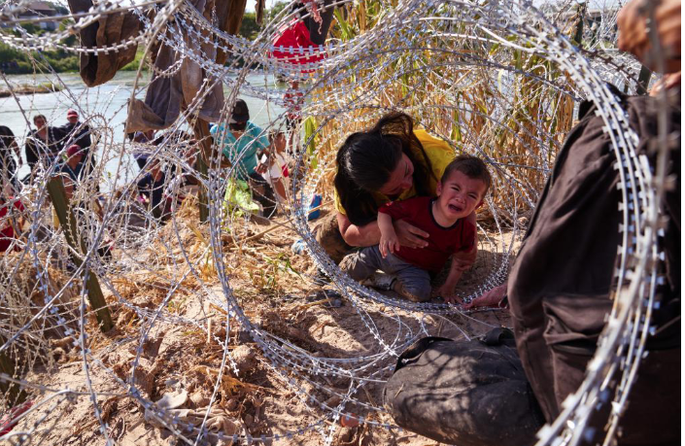
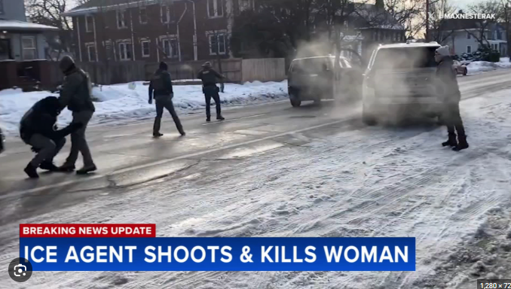
Polarizing political issues to engage students and increase participation
What would a headline be from the Far-left and Far-right for each of these issues.

Slide 9
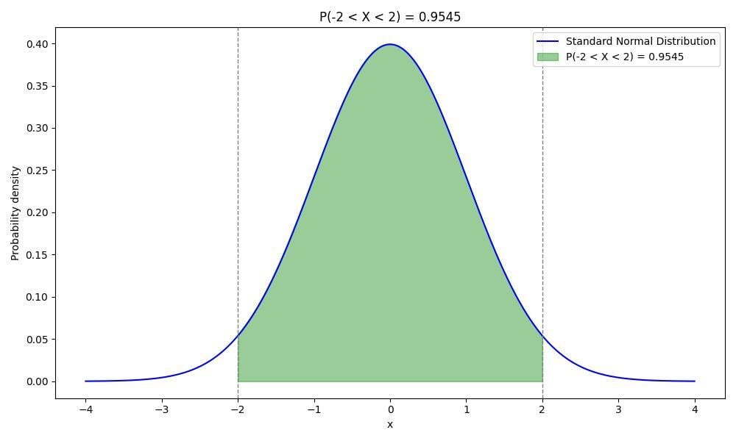
Finding the middle path between extremes
Anecdotal evidence is often from the extremes as those examples are often more compelling
The representativeness heuristic can lead you to become highly polarized
Truth is in the middle, 95.45% of the time
Cowardice Courage Recklessness
Stinginess Generous Wastefulness
Self-Doubt Confidence Arrogance
Boorishness Wittiness Buffoonery
Apathy/Laziness Ambitious Obsession
Self-deprecation Truthful Boastful
Self-deprivation Temperance Self-indulgence
Humility Proper Pride Vanity
Far Left
Far Right
“If it bleeds, it leads” – Long-standing journalism mantra originating from the 1890s

Slide 10
Examples of the Representativeness Heuristic & Conjunction Fallacy
Stereotyping Professions (The "Librarian" Example): When told someone is shy, tidy, and loves detail, people often guess they are a librarian rather than a farmer, even though farmers outnumber librarians, because the description matches the stereotypical image of a librarian
Appearance-Based Assumptions: Assuming a person in a business suit is wealthy, a person with tattoos is rebellious, or a quiet, bookish person is a professor.
Basketball Players and Height: Assuming a very tall person is a professional basketball player because they fit the physical stereotype, ignoring the low probability of being in the NBA.
The "Gambler's Fallacy": Believing that a sequence of coin flips like H-T-H-T-H-T is more likely than H-H-H-H-H-H, because the first pattern looks more random (representative of randomness) than the second, even though both are equally likely.
Medical Diagnostic Errors: A doctor might disregard a potential diagnosis because the patient's symptoms don't match the classic "prototype" of that illness, leading to misdiagnosis.
Overestimating Risk: People may believe violent crime or terrorism is an ever-present danger because these events are highly memorable and fit the media-driven image of danger, despite statistics showing they are rare.
Investment Decisions: An investor might buy a stock because the company has a "hot" reputation or high-quality products, assuming it is a good investment without analyzing the financial base rates or valuation.
Belief that sharks kill more people than hippos, falling coconuts or falling vending machines
Belief that there are more mosquitos than termites
Belief that people are more likely to be murdered than die from diabetes
Think that seeing a red sports car is more likely than seeing a sports car
Cold War example of the way a nuclear war might occur: People will choose a long but plausible explanation rather than a simple one that is one component of the longer explanation.

Slide 11

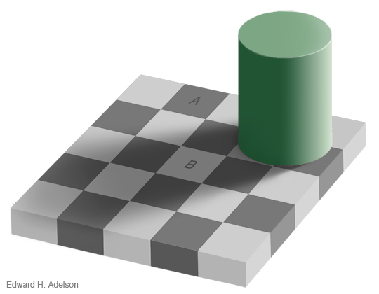
Sometimes we can’t trust our intuition, and we need cold and hard statistical facts to see more clearly
A Bat and a ball cost $3.50 and the bat is $3 more than the ball. How much did the ball cost?
After a 20% off sale a bat cost $10 what was the original price?
Which is more likely to kill a person?
A stroke OR An Accident
A tornado OR Asthma
Lightning OR Botulism
An Accident OR Diabetes

Slide 12
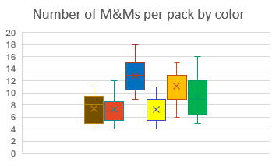
Let the activities commence!
M&M’s: The. U.S. response to UK Skittles in WWII
 | Mean | Median | Mode | Midrange | Q_{1 and} Q₃ | Range | IQR | Outliers?
Brown
Red
Blue
Yellow
Orange
Green
Total
Using TI-84 and Excel to collect data, get descriptive statistics, graphs and make a guess about a null hypothesis.
Also makes for an example of ANOVA, colors referring to different treatments for terminal cancer and frequencies representing the survival period (weeks).

Slide 13

Probability Theory
Fun with pennies (while they last) and playing cards
Pennies:
1) Estimating population size – catch and release
2) 1962 pennies don’t fall the way you’d expect – proportion test
3) Which is correct? 0%, 50%, 100%
Cards:
1) ESP testing – Binomial distribution and proportion test
2) A “stacked” deck – At what point does it become significantly weird?
3) A “magic” deck - At what point does it become significantly weird?
Bonus: The birthday match question. Relates to the number of hypotheses.

Slide 14
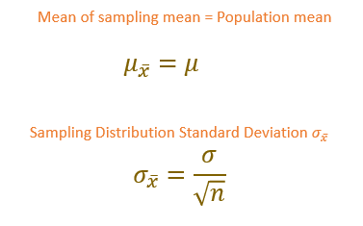
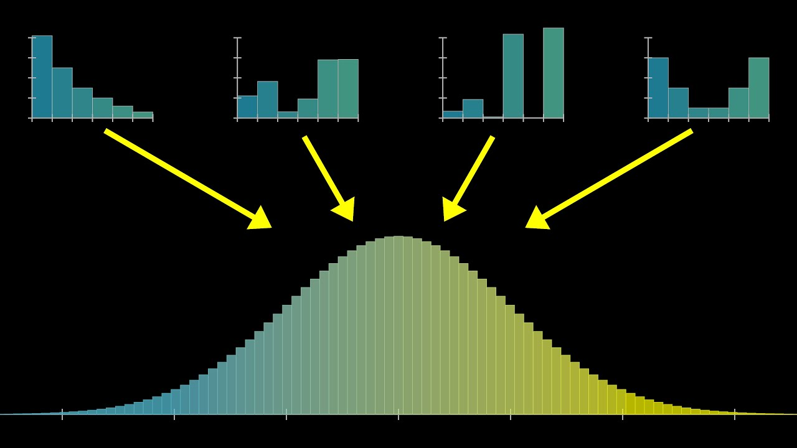
Explaining why the normal distribution is so important. The CLT
Call out either the last 4 digits of your Social Security number or the last 4 digits of your phone number… you don’t need to specify which just give me the four digits while I enter them in Excel. What do you expect the mean and standard deviation to be and which would change if your data consisted of the means of each of the 4 numbers instead of the individual values?

Slide 15
Estimation of 90% Confidence Intervals
What was Martin Luther King Jr.’s age at death?
What is the length of the Nile River in miles?
How many countries belong to OPEC?
How many books are there in the Old Testament?
What is the diameter of the moon in miles?
What is the weight of an empty Boeing 747 in pounds
In what year was Mozart born?
What is the gestation period of an African elephant in days?
What is the flying distance from Londo to Tokyo in miles?
What is the deepest part of the ocean in feet?

Slide 16

Goldfish?! Let’s participate:
Count:
X= the number of goldfish with a smile n= the number of goldfish in your bag
Say them out loud as soon as you have them while I record the data in Excel.

Slide 17
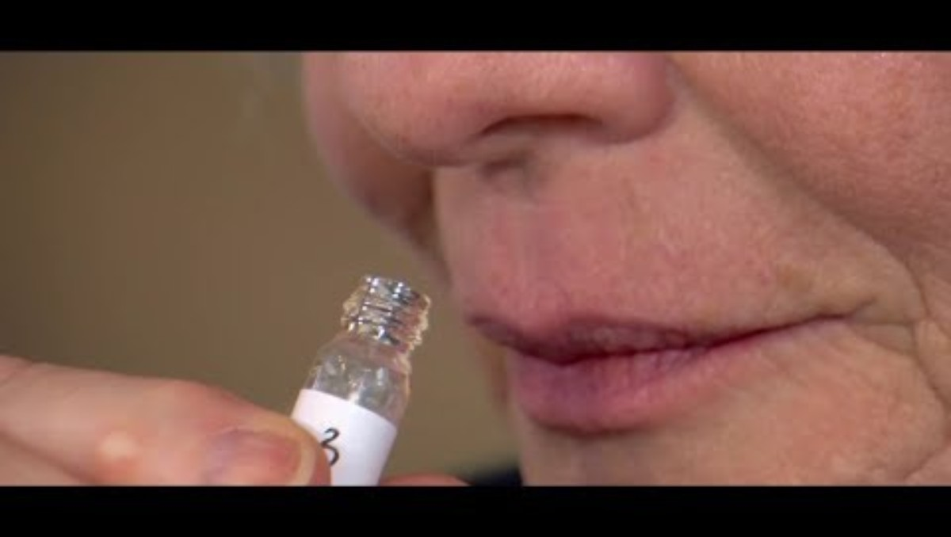
Smelling Parkinson’s Disease?!
Experimental design and proportion intervals and test
Key statistics section of documentary:
3 min -5.5 min

Slide 18
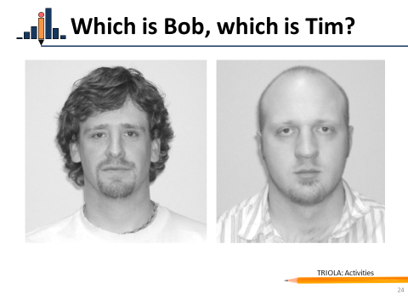
Another proportion test example that’s fun
Who is Bob, who is Tim?

Slide 19

One-Sample T-test
Do people over or under-estimate how long a minute really is. Or are they just wrong? Or in this case we might not want to reject the H0
H0: µ = 60
HA: µ >,<,≠ 60 (which inequality should we start with?)
Why do some people over-estimate and others under-estimate? What variables might help explain the variation?
Virtual Stopwatch

Slide 20
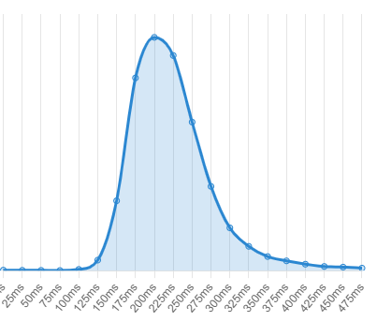

Two-sample T-test Example:
Who can react the fastest?
Let’s have a reaction timer help figure this out
Histogram of reaction times in milli-seconds
Washington U Reaction Timer

Slide 21

How old was Ghandhi when he died?

Slide 22
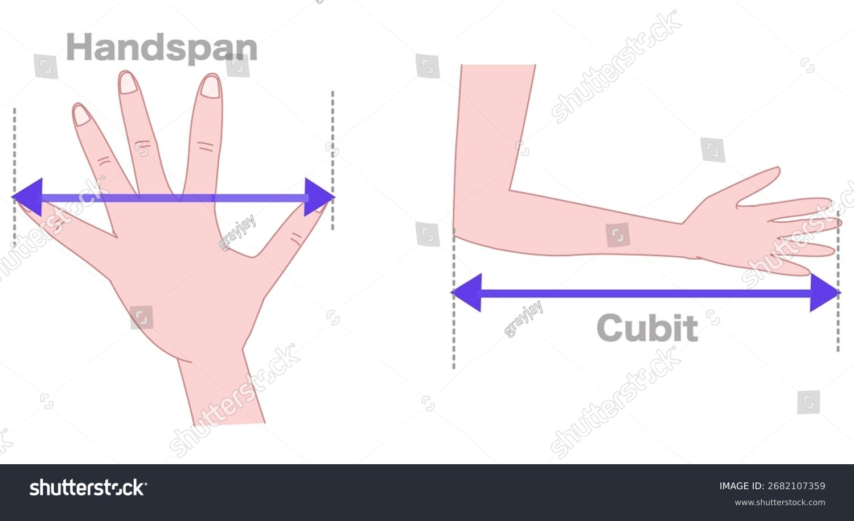
Correlation and Regression:
How strongly is the size of your hand correlated with your height?
Be able to interpret R-square and the regression equation in context.
Measure your hand span in inches, rounding to the nearest tenth (one decimal). Also state your height in inches. Remember that 5 ft = 60 inches, 6 ft = 72 inches.

Slide 23

Chi-Square: Is handedness related to throwing accuracy?
Let President Trump help you decide.
 | Hit | Miss
Dominant hand
Non-dominant hand

Slide 24

ANOVA:
Back to where we started with M&Ms
What if each color represented different treatments for patients with terminal cancer and the frequencies represented survival time in weeks.
Is there a significant difference in the average life expectancy between the treatments? How many “packs”, representing 6 people each assigned to a different treatment, do we need to collect to know the answer?

Slide 25


